Slide 1
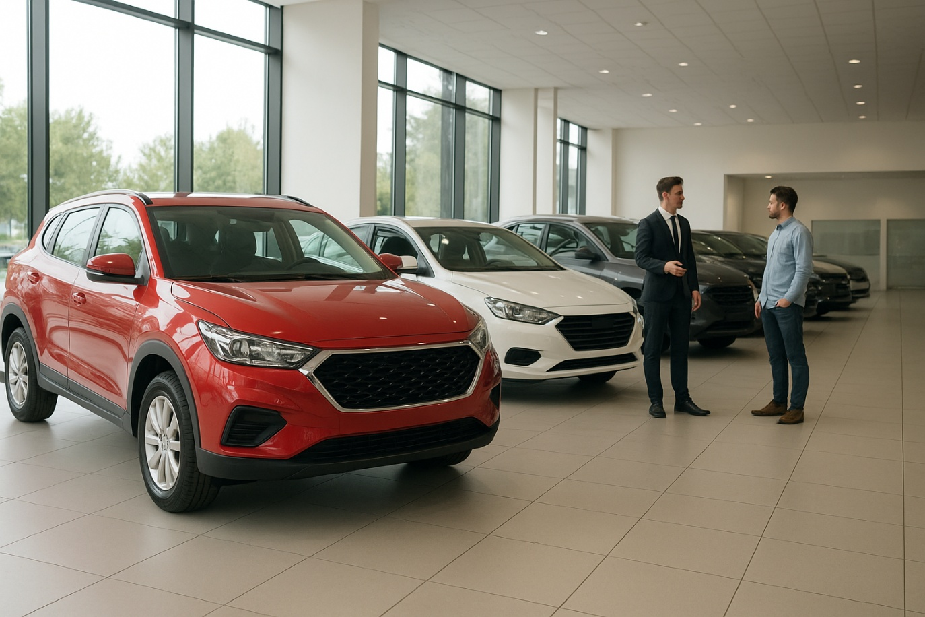

WHEALDEAL
FROM QUERIES TO CLARITY

Slide 2



ABOUT WHEALDEAL
whealDeal is a leading automotive sales company dedicated to delivering quality vehicles to customers nationwide. With a diverse portfolio of car models spanning various years of manufacture, whealDeal combines competitive pricing with trusted customer service
https://drive.google.com/file/d/1dWL1OjWyONoRWR_WNlwosJPFx61R4z6r/view?usp=drive_link

Slide 3

PROBLEM STATEMENT
A car dealership has a large dataset of used car sales containing details such as manufacturer, model, engine size, fuel type, year of manufacture, mileage, and price.
The dealership wants to gain insights into sales trends, pricing patterns, and customer preferences.
Your task is to use SQL queries to answer a series of business-driven questions. These questions are divided into three levels:
Basic Exploration
Data Analysis
Business Insights
Driving smarter decisions through whealdeal sales data insights.🚗

Slide 4
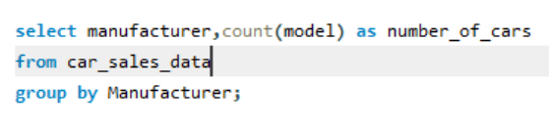
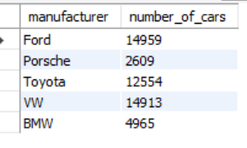
BASIC UNDERSTANDING OF DATASET
Output
Listing all distinct manufacturers available in the dataset and the number of cars available of each brand to understand the data and stock
Insight gained was ,their are a total of 5 manufacturers and FORD has the maximum stock.

Slide 5
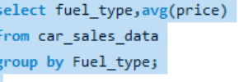
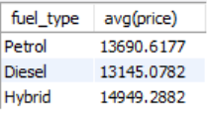
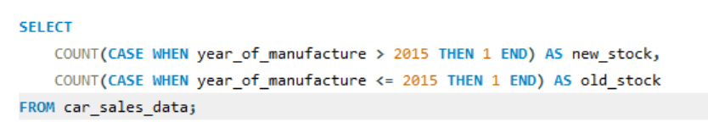
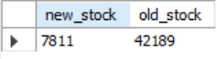
FILTERING BY YEAR
Output
Classified stock on the basis of old and new having 2015 as the base year. Items before 2015 are OLD stock and after that are NEW STOCK.
Out of 50000 cars only 7811 are made after 2015 depicting less share of new stock.
BASIC AGGREGATION
Showing the average price of cars grouped by fuel type.
Hybrid cars have the highest average price, followed by petrol and diesel cars.
Output

Slide 6
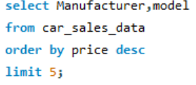
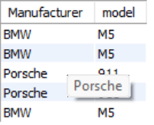
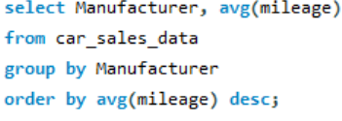
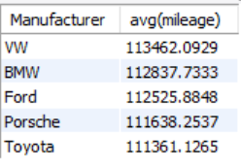
EXPLORATORY ANALYSIS
02
"Calculate the average mileage for each manufacturer, sorted by average mileage descending.
VW cars tend to have higher mileage compared to luxury brands like Audi or Porsche.
Output
Output →
01
Finding the top 5 most expensive cars in the dataset (manufacturer, model, price)
"Luxury brands like Porsche and BMW dominate the top 5 expensive cars.

Slide 7
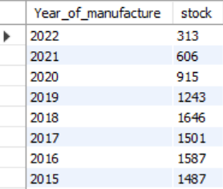
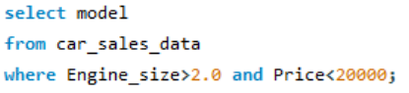
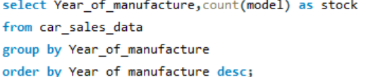
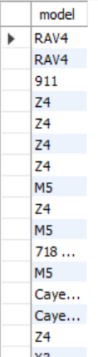
03
Finding all cars where the engine size is greater than 2.0 AND the price is below 20,000.
Output →
Output
04
Counting the number of cars manufactured each year to see the trend over time.
Most cars were manufactured in 2018, showing peak production year.

Slide 8
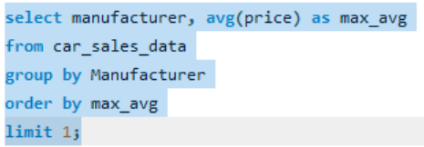
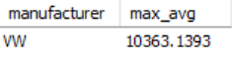
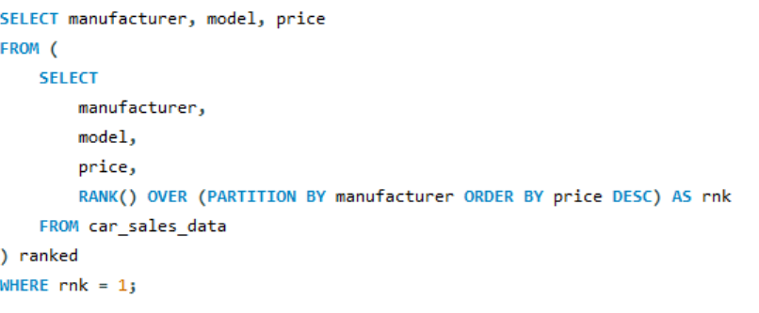
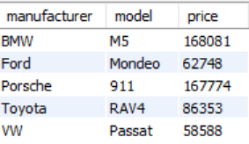
BUSINESS INSIGHTS
Finding the manufacturer whose cars have the highest average price overall
VW has the highest average price, showing it’s the premium brand in this dataset.
Output →
For each manufacturer, show the model with the highest price (manufacturer, model, max price).
Output →
Insight: Each brand’s flagship/high-end model is highlighted, useful for marketing insights.

Slide 9
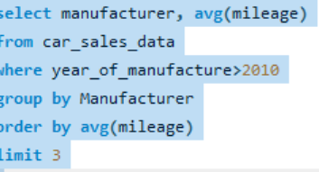
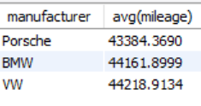
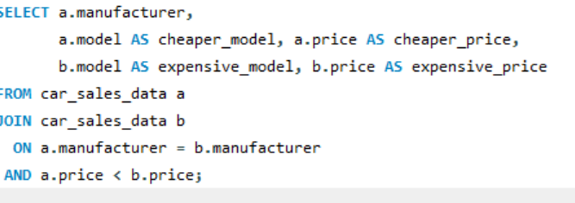
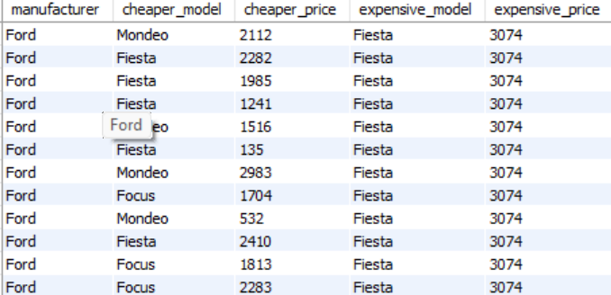
Finding the top 3 manufacturers with the lowest average mileage, but only consider cars manufactured after 2010.
Luxury brands have lower mileage on average, possibly because they’re newer or less driven.
For each manufacturer, finding pairs of models where one model is cheaper than the other

Slide 10
Conclusion
“In short, the data shows a market dominated by older cars, with hybrids and luxury brands driving value — and the opportunity lies in newer models, eco-friendly options, and targeted brand strategies.”

Slide 11
🔹 Strategic Recommendations
Focus on adding post-2015 models to attract buyers seeking newer cars.
Position hybrids as premium offerings to leverage higher demand and pricing.
Maintain a dual strategy: budget-friendly cars for value seekers, luxury cars for status-driven buyers.
Build brand-specific campaigns highlighting affordability (Ford, Toyota) vs. exclusivity (Porsche, BMW).

Slide 12

CONTACT DETAILS
NAME
khushi jagnani
E-mail
khushijagnani2000@gmail.com
Thank you!
Phone
8969947777
Address
826001,DHANBAD

